Slide 1
Mixed Reality in Power Apps
Mary Angiela Cerbolles

Slide 2



Mary Angiela “Anj” Cerbolles
Application Analyst
Twitter: @anjcerbolles
LinkedIn: https://www.linkedin.com/in/maryangielacerbolles/
Blog: https://anjcerbolles.net

Slide 3
Session Agenda
Mixed Reality in Power Platform
Mixed Reality in Power Apps
Requirements
Let’s start building

Slide 4
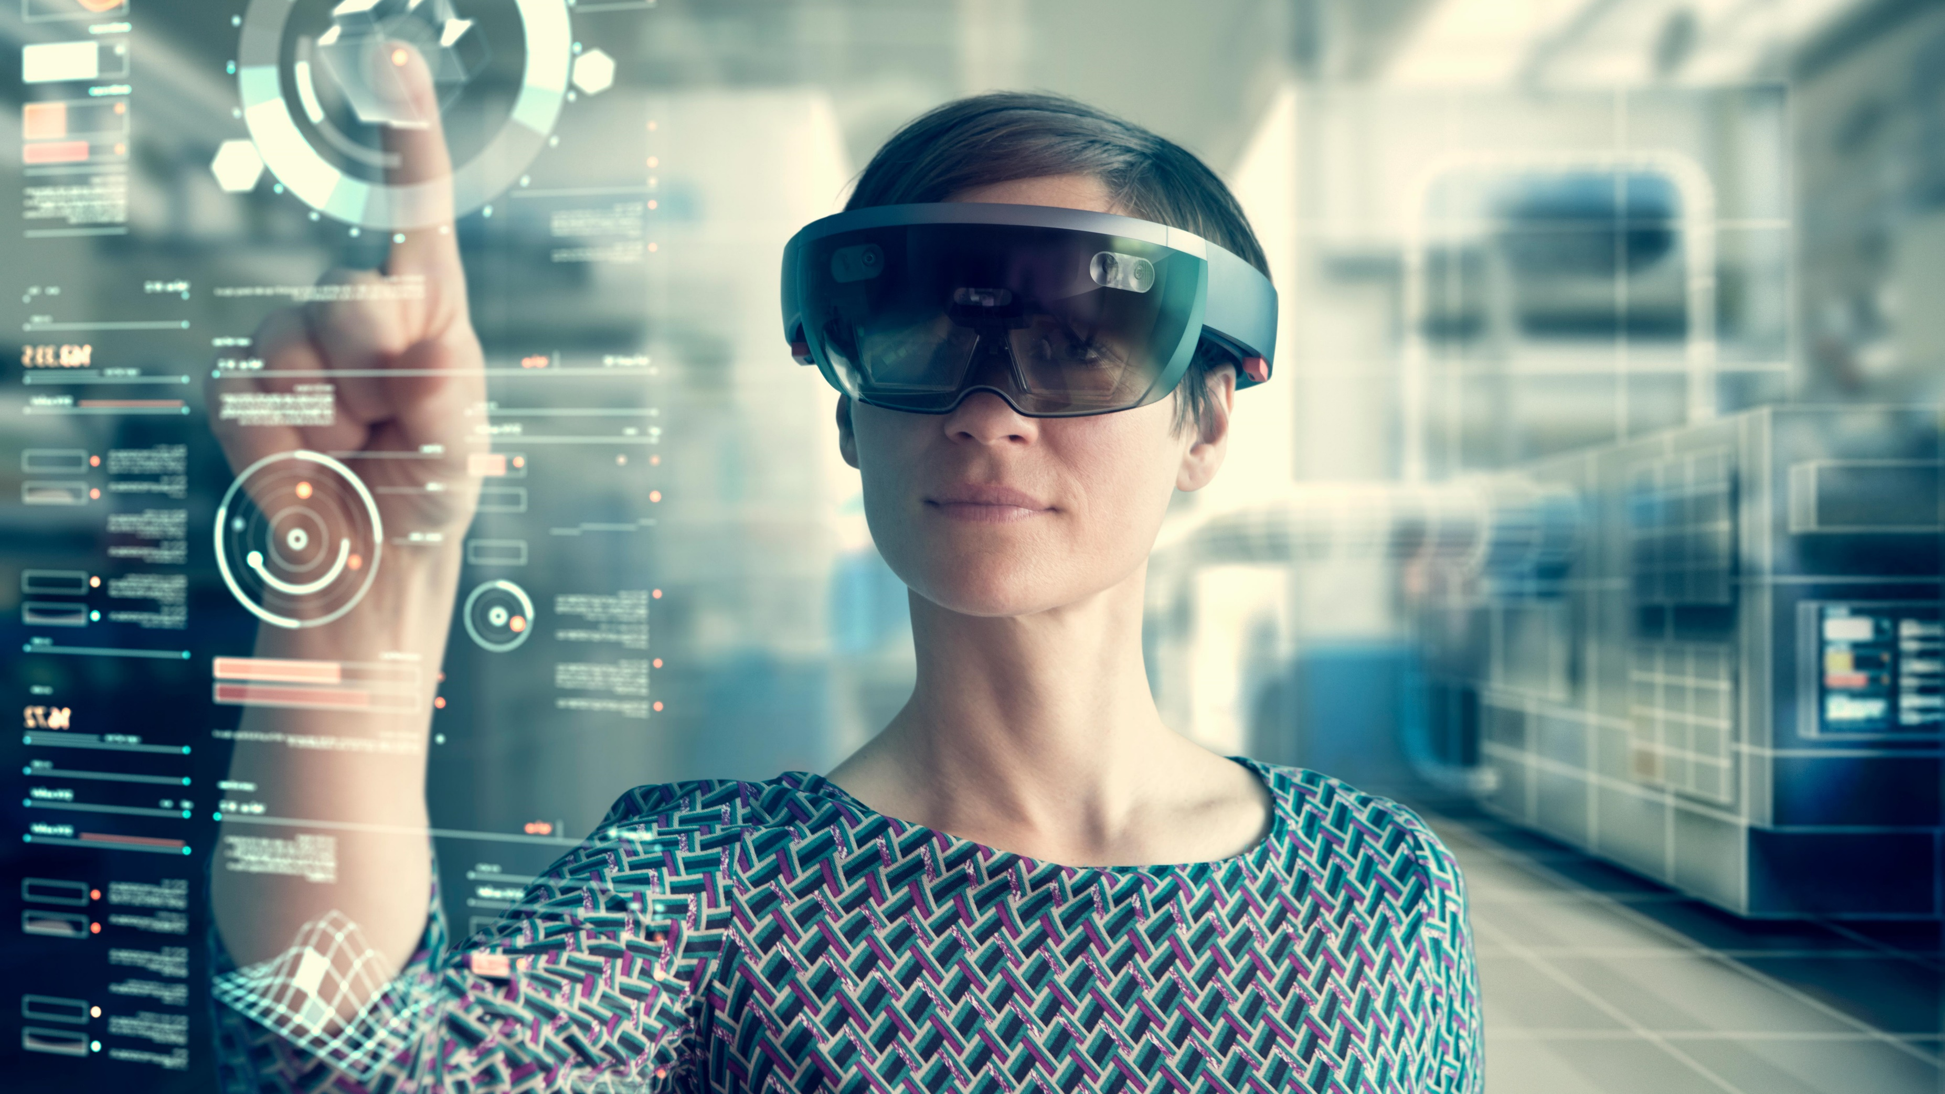

Slide 5
20% - currently in production or deploying Mixed Reality
67% - currently exploring use cases or piloting Mixed Reality
87%
* Source: Harvard Business Review Analytic Services Survey, March 2018

Slide 6
* Source: Harvard Business Review Analytic Services Survey, March 2018

Slide 7
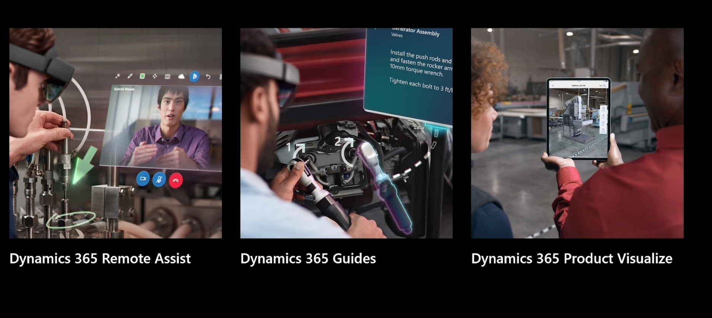
Mixed Reality in Power Platform

Slide 8
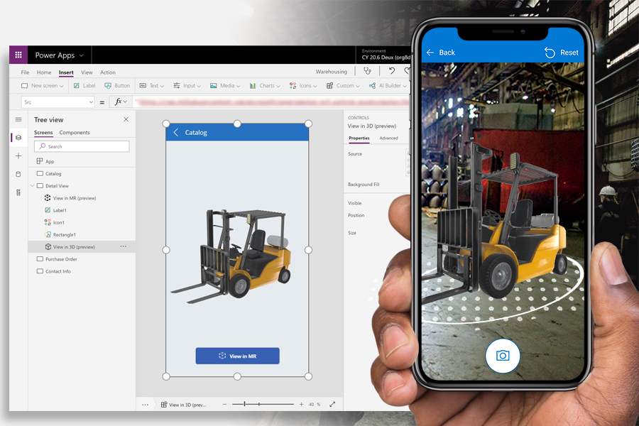
Mixed Reality in Power Apps
Visualize 3D objects and 2D images
Take measurements
Place Objects

Slide 9
Mixed Reality Components
View in 3D objects and 2D objects
View in Mixed Reality
Measurements (Area, Volume, Distance)
View Shapes

Slide 10
Requirements
Enable Mixed Reality Features in each Canvas App
Mixed Reality-capable device (ARCore capable device)
.GLB file type

Slide 11
Demo View in 3D object

Slide 12
Demo Measurement and Placing Objects

Slide 13
Demo View Shape in Mixed Reality

Slide 14
Roadmap & Reference
General Availability in October
SpaceR Solution for hackathon using MR components - https://youtu.be/j15u0kz1588
Mixed Reality On-Demand Session in Microsoft Business Application
https://mymbas.microsoft.com/sessions/7b527160-9bbe-4f27-8972-c00d3f73e44f?source=sessions
Add Mixed Reality Components in Canvas App
https://docs.microsoft.com/en-us/powerapps/maker/canvas-apps/mixed-reality-overview
Power Apps Ideas Forum
https://aka.ms/powerAppsMRIdeas
Power Apps Community - https://powerusers.microsoft.com/

Slide 16
Thank you
Mary Angiela Cerbolles
anj.cerbolles@outlook.com
https://anjcerbolles.net
https://twitter.com/anjcerbolles

